Slide 1
Murach’s Modern JavaScript
Chapter 4
How to work with arrays and strings

Slide 2
Objectives
Applied
Create arrays and add, replace, or delete its elements.
Use for, for-in, and for-of loops with arrays.
Use the methods of an Array object to modify, copy, inspect, and transform an array.
Use the methods of a String object to inspect and modify a string.
Split a string into an array and convert an array to a string.
Chain method calls.
Knowledge
Describe when you would use for, for-in, and for-of loops with arrays.

Slide 3
Syntax for creating an array using an array literal
const arrayName = [values];
Syntax for referring to an element of an array
arrayName[index]
A property of an array
length

Slide 4
Create an array and add three elements
const amounts = [];
amounts[0] = 141.95;
amounts[1] = 212.25;
amounts[2] = 411;
Create an array and add three elements with a single statement
const amounts = [141.95, 212.25, 411];

Slide 5
Refer to the elements in an array
amounts[0] // first element – returns 141.95
amounts[1] // second element – returns 212.25
amounts[2] // third element – returns 411
amounts[3] // element doesn't exist
// returns undefined
Determine how many elements are in an array
const count = amounts.length; // 3
Code that fails when you assign a new array to a constant
amounts = [550.95, 620.50, 722];
// TypeError: Assignment to constant variable.

Slide 6
Add an element to the end of an array
const numbers = [1, 2, 3]; // array is 1,2,3
numbers[numbers.length] = 4; // array is 1,2,3,4
Add an element at a specific index
const numbers = [1, 2, 3]; // array is 1,2,3
numbers[5] = 6; // array is 1,2,3,,,6
const len = numbers.length; // len is 6
Replace an element at a specific index
const numbers = [1, 2, 3]; // array is 1,2,3
numbers[1] = 20; // array is 1,20,3

Slide 7
Delete an element at a specific index
const numbers = [1, 2, 3]; // array is 1,2,3
delete numbers[1]; // array is 1,,3
const num = numbers[1]; // num is undefined
Remove all elements
const numbers = [1, 2, 3]; // array contains 3 elements
numbers.length = 0; // removes all elements

Slide 8
Put the numbers 1 through 10 into an array
const numbers = [];
for (let i = 0; i < 10; i++) {
numbers[i] = i + 1;
}
Display the numbers in the array
let displayString = "";
for (let i = 0; i < numbers.length; i++) {
displayString += numbers[i] + " ";
}
alert(displayString); // displays 1 2 3 4 5 6 7 8 9 10

Slide 9
Put four amounts into an array
const amounts = [];
amounts[0] = 141.95;
amounts[1] = 212.25;
amounts[2] = 411;
amounts[3] = 135.75;
Total the amounts in the array
let total = 0;
for (let i = 0; i < amounts.length; i++) {
total += amounts[i];
}

Slide 10
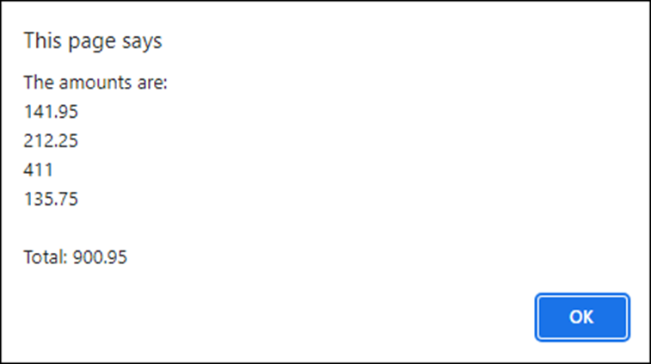
Display the amounts and the total
let amountsString = "";
for (let i = 0; i < amounts.length; i++) {
amountsString += amounts[i] + "\n";
}
alert("The amounts are:\n" +
amountsString + "\n" +
"Total: " + total);
The message that’s displayed

Slide 11
How to use the for-in loop
The syntax
for (let index in array) {
statements
}
Total the numbers in the array
let total = 0;
for (let i in amounts) { // variable i holds the
// current index
total += amounts[i]; // use the index to get
// current value
}
alert(total); // displays 900.95

Slide 12
How to use the for-of loop
The syntax
for (let element of array) {
statements
}
Total the numbers in the array
let total = 0;
for (let amount of amounts) { // variable amount holds
// the current value
total += amount;
}
alert(total); // displays 900.95

Slide 13
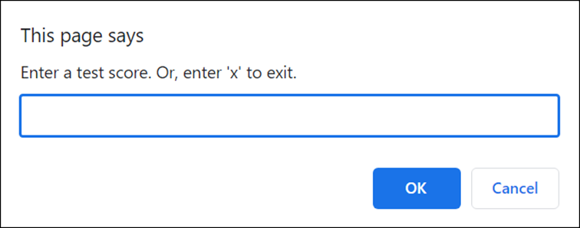
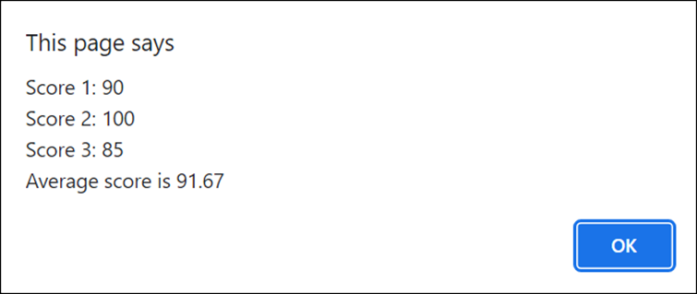
Dialogs for the Test Scores app
Prompt the user for scores
Display the scores and their average

Slide 14
The JavaScript for the Test Scores app (part 1)
const scores = [];
// get scores from the user
while (true) {
const entry =
prompt("Enter a test score. Or, enter 'x' to exit.");
if (entry === 'x' || entry === null) {
break;
}
const score = parseInt(entry);
if (score >= 0 && score <= 100) {
scores[scores.length] = score;
} else {
alert("Score must by a valid number from 0 through 100.");
}
}

Slide 15
The JavaScript for the Test Scores app (part 2)
// calculate total and average and display, or notify user
// if no scores
if (scores.length === 0) {
alert("You didn't enter any scores.");
} else {
let total = 0;
let scoresString = "";
for (let i in scores) {
total += scores[i];
scoresString += `Score ${parseInt(i) + 1}: ${scores[i]}\n`;
}
const average = total/scores.length;
// display the scores and their average
alert(`${scoresString}Average score: ${average.toFixed(2)}`);
}

Slide 16
Methods that modify or copy an array
push(elements)
pop()
unshift(elements)
shift()
splice(start, number, elements...)
slice(start, end)

Slide 17
The names array used by the following examples
const names = ["Grace","Charles","Ada"];
Add and remove elements from end of array
names.push("Alan", "Linus");
// ["Grace","Charles","Ada","Alan","Linus"]
let removed = names.pop(); // removed is Linus
// ["Grace","Charles","Ada","Alan"]
Add and remove from beginning of array
names.unshift("Linus");
// ["Linus","Grace","Charles","Ada","Alan"]
removed = names.shift(); // removed is Linus
// ["Grace","Charles","Ada","Alan"]

Slide 18
Remove, add, and replace elements from a specific index
removed = names.splice(1, 2);
// removed is ["Charles","Ada"]
// ["Grace","Alan"]
names.splice(1, 0, "Charles", "Ada");
// ["Grace","Charles","Ada","Alan"]
names.splice(1, 2, "Mary", "Linus");
// ["Grace","Mary","Linus","Alan"]

Slide 19
Copy some elements to a new array
const partialCopy = names.slice(1, 3);
// partialCopy is ["Mary","Linus"]
const allButLast = names.slice(0, -1);
// allButLast is ["Grace","Mary","Linus"]
Copy all the elements to a new array
const fullCopy = names.slice();
// fullCopy is ["Grace","Mary","Linus","Alan"]

Slide 20
Methods that inspect or transform an array
indexOf(value, start)
lastIndexOf(value, start)
includes(value, start)
at(index)
join(separator)
toString()
reverse()

Slide 21
An array that’s used by the following examples
const numbers = [1,2,3,4,5,6,7,8,9,10];
Two ways to check if a value is in the array
if (numbers.includes(5)) { ... }
if (numbers.indexOf(5) != -1) { ... }
Two ways to get the last element in the array
let last = numbers[numbers.length - 1]; // last is 10
last = numbers.at(-1); // last is 10

Slide 22
Three ways to convert an array to a string
let str = numbers.join();
// str is "1,2,3,4,5,6,7,8,9,10"
str = numbers.join(", ");
// str is "1, 2, 3, 4, 5, 6, 7, 8, 9, 10"
str = numbers.toString();
// str is "1,2,3,4,5,6,7,8,9,10"
Reverse the elements in an array
numbers.reverse(); // numbers is [10,9,8,7,6,5,4,3,2,1]

Slide 23
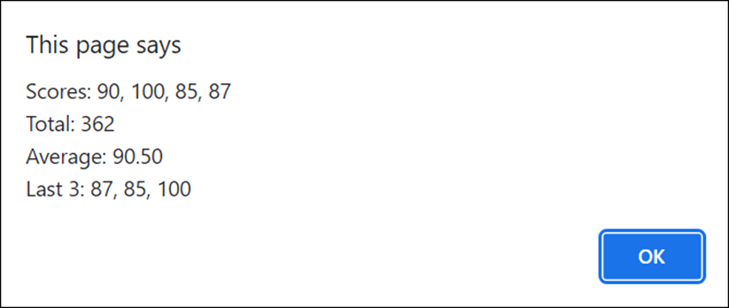
A dialog with the results of the Test Scores 2.0 app

Slide 24
JavaScript for the Test Scores 2.0 app (part 1)
const scores = [];
while (true) {
const entry =
prompt("Enter a test score. Or, enter 'x' to exit.");
if (entry === 'x' || entry === null) {
break;
}
const score = parseInt(entry);
if (score >= 0 && score <= 100) {
scores.push(score);
} else {
alert("Score must by a valid number from 0 through 100.");
}
}

Slide 25
JavaScript for the Test Scores 2.0 app (part 2)
const len = scores.length;
if (len === 0) {
alert("You didn't enter any scores.");
} else {
// calculate total and average
let total = 0;
for (let score of scores) {
total += score;
}
const average = total/len;
// get the last 3 scores in reverse order
const lastScores =
(len <= 3) ? scores.slice() : scores.slice(len - 3, len);
lastScores.reverse();
// display score data
alert("Scores: " + scores.join(", ") + "\n" +
"Total: " + total + "\n" +
"Average: " + average.toFixed(2) + "\n" +
"Last 3: " + lastScores.join(", "));
}

Slide 26
Property for inspecting a string
length
Methods for inspecting a string
at(position)
indexOf(search, start)
startsWith(search)
endsWith(search)
includes(search, start)

Slide 27
The constant used by the following examples
const str = "JavaScript";
Get the length of a string
str.length // 10
Get one character
str.at(4) // "S"
str.at(-1) // "t"
Get index values
str.indexOf("a") // 1
str.indexOf("a", 2) // 3
str.indexOf("s") // -1

Slide 28
Check whether a string contains the specified text
str.startsWith("Java") // true
str.startsWith("java") // false
str.endsWith("Script") // true
str.includes("ava") // true
str.includes("ava", 2) // false

Slide 29
Methods for modifying a string
substring(start, end)
toLowerCase()
toUpperCase()
trimStart()
trimEnd()
trim()
padStart(length)
padEnd(length)
replace(old, new)
replaceAll(old, new)
repeat(times)

Slide 30
A constant used by the following examples
const str = "JavaScript";
Get substrings
str.substring(4) // "Script"
str.substring(0, 4) // "Java"
Convert case
str.toLowerCase() // "javascript"
str.toUpperCase() // "JAVASCRIPT"
Pad the start or end of a string
str.padStart(str.length + 3) // " JavaScript"
str.padEnd(str.length + 3) // "JavaScript "

Slide 31
Trim whitespace from the start or end of a string
const str2 = " JavaScript ";
str2.trimStart() // "JavaScript "
str2.trimEnd() // " JavaScript"
str2.trim() // "JavaScript"
Replace a substring with a new string
str.replace("a", "@"); // "J@vaScript"
str.replaceAll("a", "@"); // "J@v@Script"
Repeat a string
"*".repeat(20); // "********************"

Slide 32
A method for creating an array from a string
split(separator)
Two constants used by the following examples
const fullName = "Grace M Hopper";
const date = "7-4-2023";
Split a string that’s separated by spaces into an array
const names = fullName.split(" ");
// names is ["Grace","M","Hopper"]
const len = names.length;
// len is 3
const lastName = names[len - 1];
// lastName is "Hopper"

Slide 33
Split a string that’s separated by hyphens into an array
const dateParts = date.split("-");
// dateParts is ["7","4","2023"]
const month = dateParts[0]; // month is "7"
const year = dateParts[2]; // year is "2023"
Split a string that’s separated by commas and spaces into an array
const names = "Bob, Anne, Mike";
const namesParts = names.split(", ");
// namesParts is ["Bob","Anne","Mike"]
Split a string into an array of characters
const characters = fullName.split("");
// ["G","r","a","c","e"," ","M"," ","H","o","p","p","e","r"]

Slide 34
What happens if the string doesn’t contain the separator
const dateParts = date.split("/");
// dateParts is ["7-4-2023"]
len = dateParts.length; // len is 1
What happens if the string contains the separator at the beginning or end
const path = "/directory/";
const pathParts = path.split("/");
// pathParts is ["","directory",""]

Slide 35
Capitalize the first letter of a name
let name = "grace";
Without method chaining
let firstLetter = name.substring(0, 1);
firstLetter = firstLetter.toUpperCase();
name = firstLetter + name.substring(1);
With method chaining
name = name.substring(0, 1).toUpperCase() +
name.substring(1);

Slide 36
Convert a string to lowercase without punctuation or extra spaces
const text = ` JavaScript, often abbreviated as JS, is a programming language that is one of the core technologies of the World Wide Web, alongside HTML and CSS. `;
Without method chaining
let words = text.replaceAll("\n", "");
words = words.replaceAll(",", "");
words = words.replaceAll(".", "");
words = words.trim();
words = words.toLowerCase();
// `javascript often abbreviated as js...`
With method chaining
const words = text
.replaceAll("\n", " ")
.replaceAll(",", "")
.replaceAll(".", "")
.trim()
.toLowerCase();
// `javascript often abbreviated as js...`

Slide 37
Use method chaining to get the third word in a string of words
const thirdWord = words.split(" ").at(2);

Slide 38
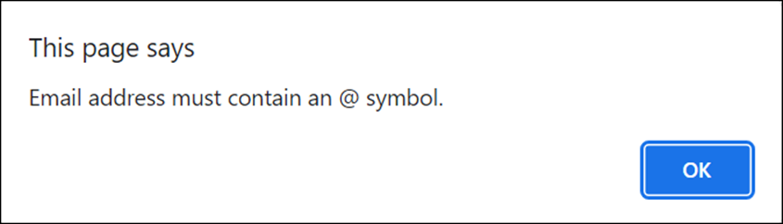
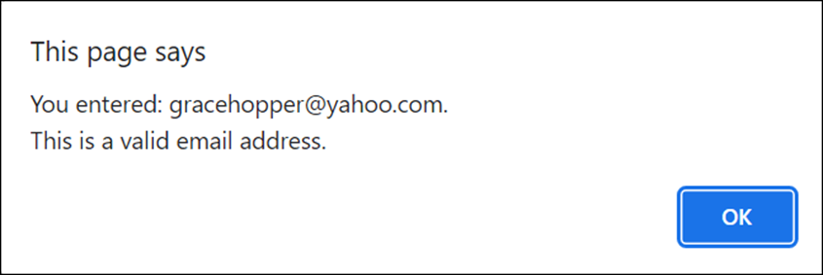
Dialogs of the Email Check app
Displays when the email address is invalid
Displays when the email address is valid

Slide 39
The email address rules that the app uses
The email address may not start with a period or an underscore.
The email address must contain an @ symbol and a period.
The period must come after the @ symbol.

Slide 40
The JavaScript for the Email Check app
let isValid = false;
while (!isValid) {
const email = prompt("Enter your email address:");
if (email.startsWith("_") || email.startsWith(".")) {
alert("Email address may not start with a period " +
"or underscore.");
} else if (!email.includes("@")) {
alert("Email address must contain an @ symbol.");
} else if (!email.includes(".")) {
alert("Email address must contain a period.");
} else if (!email.includes(".", email.indexOf("@"))) {
alert("The period must come after the @ symbol.");
} else {
alert(`You entered: ${email}.\nThis is a valid email address.`);
isValid = true;
}
}

Slide 41
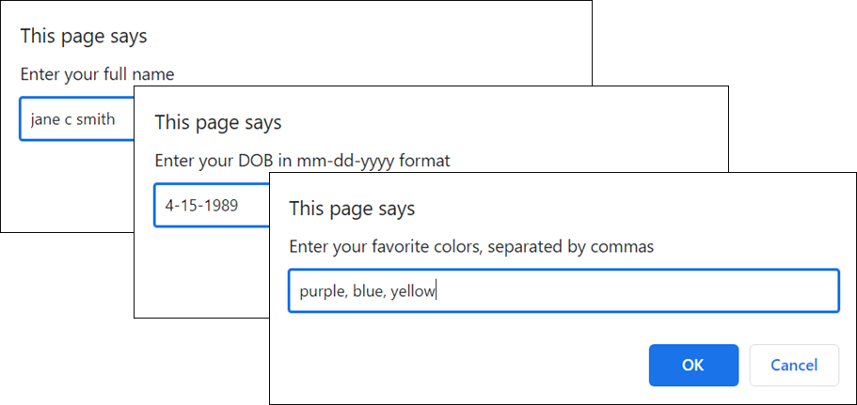
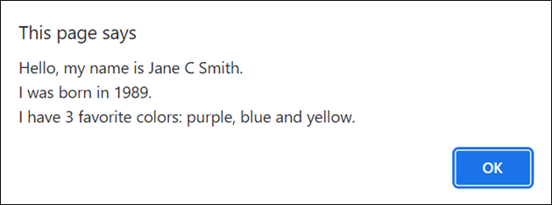
Dialogs for the Bio app
Prompt the user for their bio information
Display the user’s bio

Slide 42
The JavaScript for the Bio app (part 1)
// get name, dob, and colors and split into arrays
const names = prompt("Enter your full name").split(" ");
const dob =
prompt("Enter your DOB in mm-dd-yyyy format").split("-");
const colors = prompt("Enter your favorite colors,
separated by commas").split(",");
// capitalize each name in array
for (let i in names) {
const firstLetter =
names[i].substring(0, 1).toUpperCase();
const restOfName =
names[i].substring(1).toLowerCase();
names[i] = firstLetter + restOfName;
}
// trim any spaces from colors
for (let i in colors) {
colors[i] = colors[i].trim();
}

Slide 43
The JavaScript for the Bio app (part 2)
// create a display string for the colors
const firstColors = colors.slice(0, -1);
const lastColor = colors.at(-1);
const colorString =
`${firstColors.join(", ")} and ${lastColor}`;
// display bio
alert(`Hello, my name is ${names.join(" ")}.
I was born in ${dob[2]}.
I have ${colors.length} favorite colors: ${colorString}.`);

